Slide 1
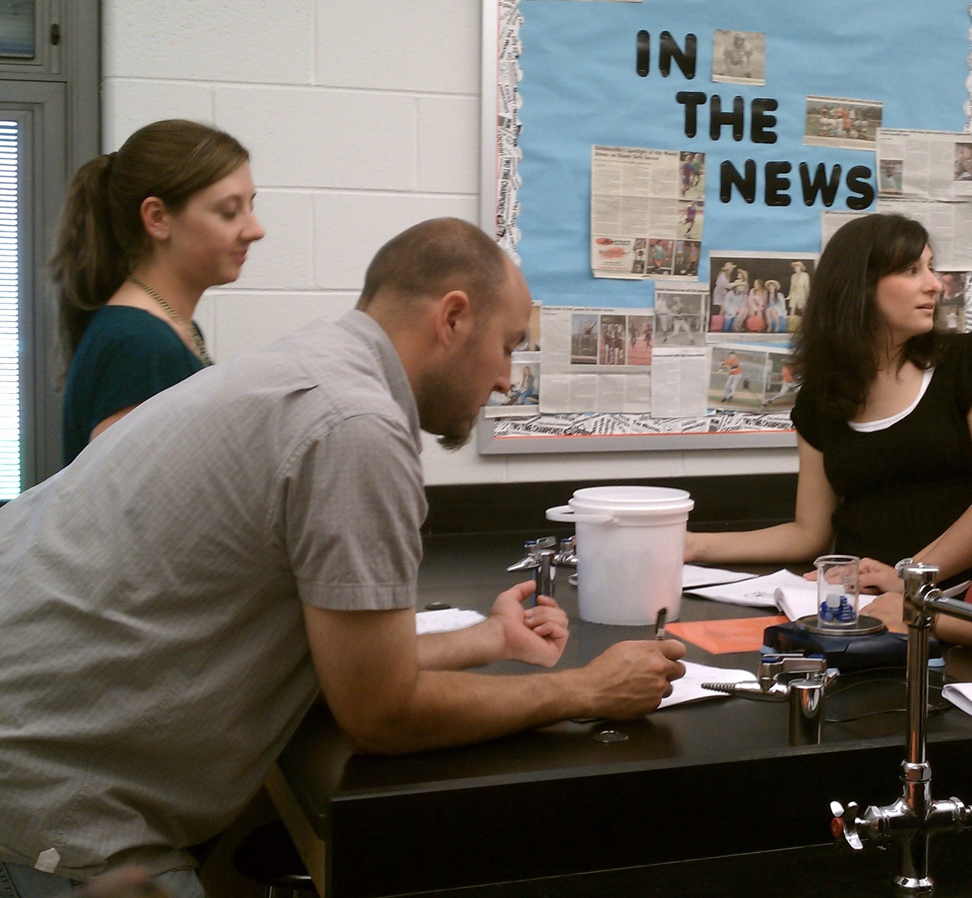
ROBBINSVILLE PUBLIC SCHOOL DISTRICT
Presentation of Learning
June 30, 2011

Slide 2
THINKING ABOUT THE PAST
What did we learn?
Importance of developing “Big Ideas”
Promoted consistent, common focus among teaching staff
Allowed flexibility in adaptation across grades/subjects
Value of collaborating with colleagues
Helped generate diversity of inputs and ideas, brainstorming
Different grade levels share many similar obstacles
Across grade levels, many students struggle to perform simple measurements and related calculations
Value of finding cross-curricular solutions
Measurement problem common across math and science classes

Slide 3
THINKING ABOUT THE PAST
What do we count as our successes? Why?
Developed an authentic “Big Idea” for our district
“Big Idea”: Measurement Focus across math and science classes
Addressed a cross-grade level problem not previously identified
Developed lessons at all grade levels addressing the “Big Idea”
Workshop presented to math and science content teachers at all grade levels during In-Service Day
Teachers implemented lessons presented
Provided instruction on Differentiated Instruction to high school math/science teachers
Math CPIs created by district coaches

Slide 4
THINKING ABOUT THE PAST
What do we wish we had done differently?
Presented workshop to colleagues earlier in the school year so that ideas could be implemented sooner
What did we not complete?
Benchmark assessments have not yet been finalized for each grade level

Slide 5
THINKING ABOUT THE PAST
What obstacles did we encounter? What did we do to overcome them? What worked? Why?
Coordination and information gathering challenges due to staff schedule conflicts/limitations
Solutions included additional meetings with partial/smaller groups; timely sharing of information via email to full group
Flexibility and information sharing well received - helped to encourage participation and increase idea generation/discussion

Slide 6
IMPRINT AND IMPACT
How has our CONNECT-ED work imprinted itself on those directly involved in our PLC work and what we do in our classrooms, schools, and districts?
Encouraged participants to think more broadly in terms of “Big Ideas”, across grade levels and curriculum
Resulted in participants directly seeing benefits of their active involvement and welcoming collaboration

Slide 7
IMPRINT AND IMPACT
How has our CONNECT-ED work had an impact in our school and our district? What kind of impact? On whom? How do we know?
More “Big Idea” thinking starting to develop across other content areas and grade levels
Trickle-down effect with staff in other subject areas, including reading, writing, and social studies
Positive feed back from staff; early collaboration/discussions looking for other “Big Ideas”

Slide 8
ENVISIONING THE FUTURE
What does our CONNECT-ED work look like in the future?
Incorporate “Big Idea” thinking into curriculum development based on Core Content Standards
Encourage continued communication, brainstorming, collaboration

Slide 9
ENVISIONING THE FUTURE
How do we want to carry our CONNECT-ED work forward?
Expand PLC work to include other content areas

