Slide 1
Presentation of Learning
Summer Leadership Institute 2011
Members Present
Mary Yeomans
Michelle Hamilton
Nick Johnson
Katie Santini

Slide 2
Thinking about the Past (Year 1: 2008 - 2009)
Participated in 6 days of PLC Training
Examined the Atlas of Scientific Literacy
Chose a strand that supports district goals
Read and discussed journal articles and one book related to writing in science
Met monthly to continue conversation and plan next steps
Visited middle and high school science classrooms

Slide 3
Thinking about the Past (Year 2: 2009 - 2010)
Added a high school member (Nick Johnson)
Continued to meet monthly
Instituted 3 school-based PLCs
Created pre- and post-assessments to track student progress in scientific literacy
Attended 5 days of PLC Training
Attended state and national science conventions
Read several scientific literacy books

Slide 4
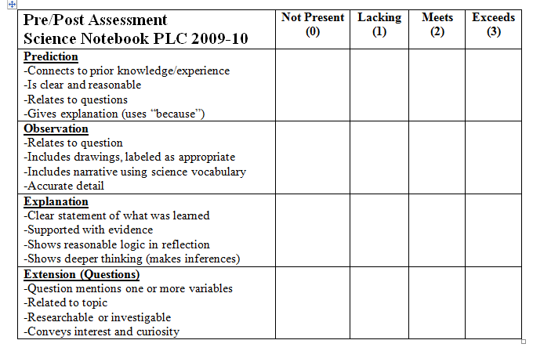
Thinking about the Past (Year 3: 2010 - 2011)
Professional Development was offered in district
Added two new members (Katie Santini and Greg Hunter)
Attended state science convention
Continued PLC and Leadership Training
Read and discussed The Essentials of Science and Literacy
Altered the fractions miniBIM for presentation to administrators
Creating a rubric to assess student science literacy
Developing our own miniBIM . . .

Slide 5
Imprint:
Writing has been infused in our everyday science routines
Assigned readings have sparked deep conversations
The value of vertical articulation
Impact:
150+ staff/administrators out of 400 have been “touched”
Student writing, questioning and conversation in the science classroom has improved
- During year 2, students increased their scientific literacy score by 71%

Slide 6
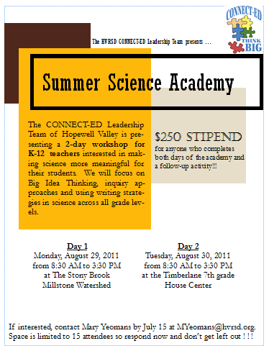
Envisioning the Future:
. . . our own Science Literacy miniBIM will be presented this summer in a 2-day Summer Science Academy
Follow-up will be provided for attendees of the Academy
Continue the PLC Leadership team
Continue PD by reading and discussing another book
Hope to encourage vertical articulation across all district PLC’s
Apply to Phase III !!!

